Slide 1
PGST Meeting 2/20

Slide 2
Today's Agenda
PSE Battery Flex Program
Analyzing Utility Plate Data
Candidate Solar Array Locations
Propane Data Analysis and Heating Profile Assumptions
ReOpt Assumptions
Next Steps

Slide 3
PSE Battery Flex Program
Flex event - time of high demand
$75 per kWh battery storage
$0.50 per kWh for participation in flex events
Devices are automatically discharged
To no less than 20% of battery capacity
Clinic batteries are ~60kWh, ~120kWh total
$9000 initial, $48 per flex event

Slide 4
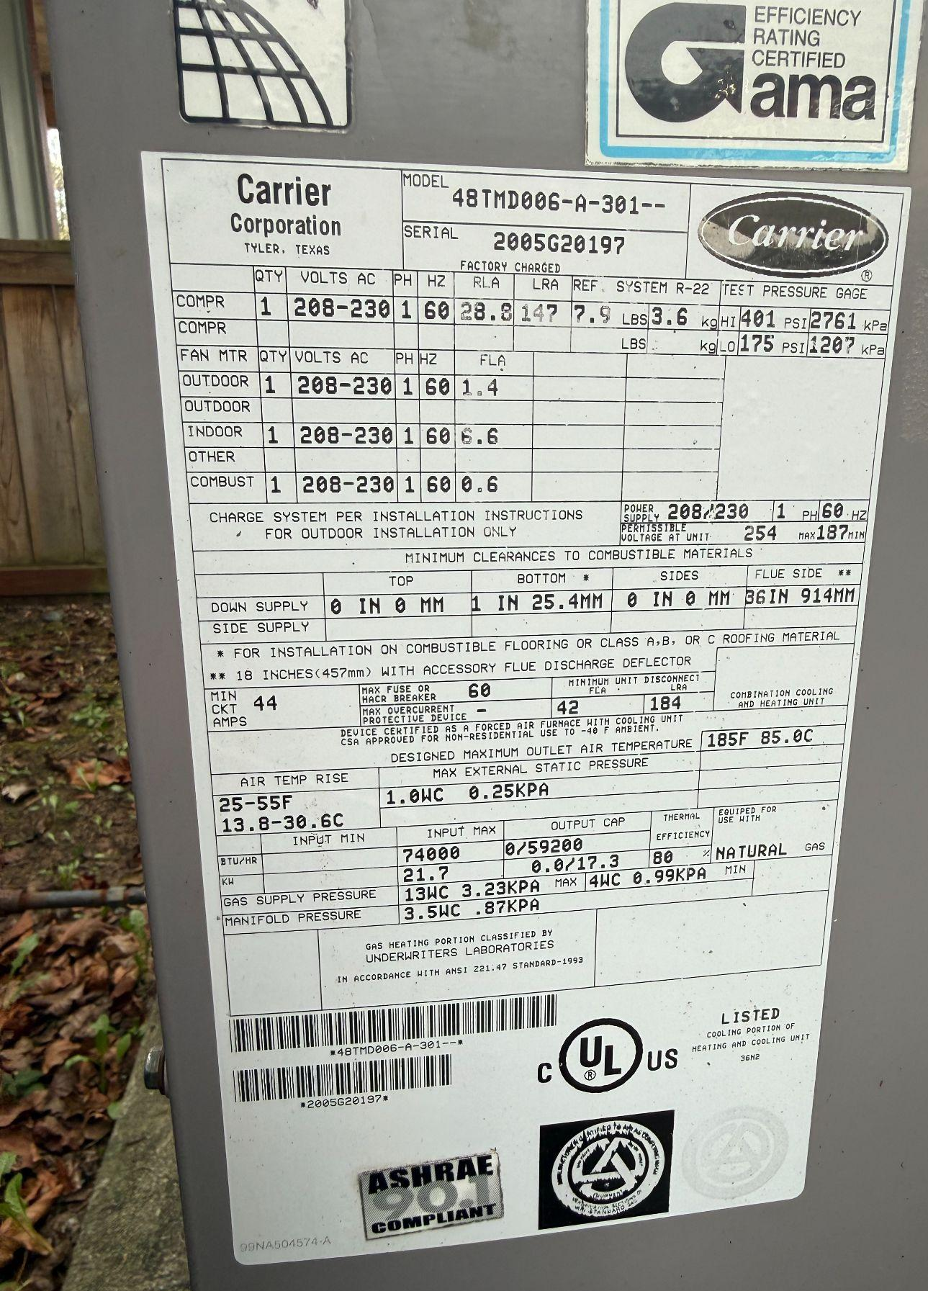
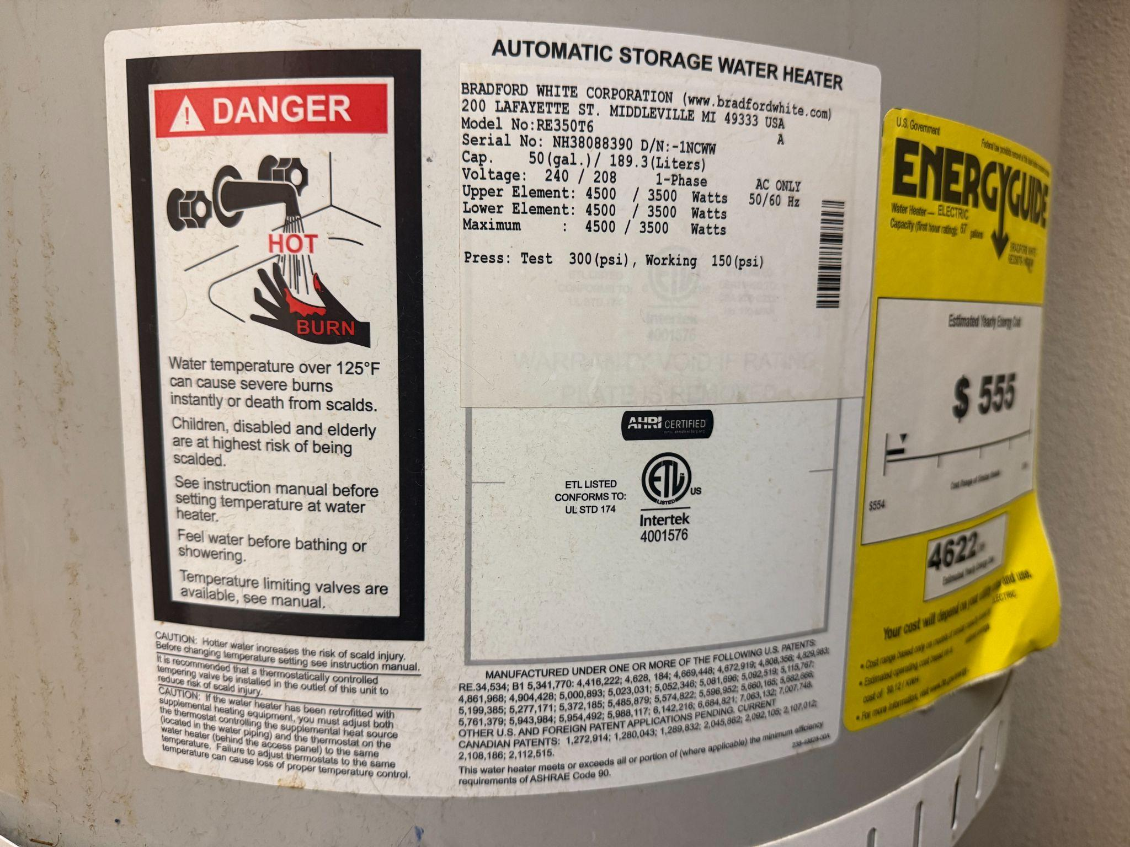
Analyzing Plate Data
Plates tell us:
Temperature, pressure, voltage, phase, thermal efficiency, etc.
Fuel capacity and consumption
Serial/Model Numbers → Useful for looking up manuals for additional information

Slide 5
Analysing Plate Data
Energy Output / Propane Input = Efficiency
91500 BTU/gal Propane
Neglecting kitchen stoves
Highest input for boiler type was used
Propane Consuming Units | Thermal Efficiency (%) | Propane Input (BTU/hr) | Energy Output (BTU/hr) | Propane Input (gal/hr) | Energy Output (gal/hr)
Boiler | 83% | 542000 | 449589 | 5.927 | 4.916
Gym Furnace | 81% | 400000 | 324000 | 4.374 | 3.543
CFS Furnace 1 | 80% | 74000 | 59200 | 0.809 | 0.647
CFS Furnace 2 | 80% | 74000 | 59200 | 0.809 | 0.647
CFS Furnace 3 | 80% | 74000 | 59200 | 0.809 | 0.647
CFS Furnace Total | 80% | 222000 | 177600 | 2.428 | 1.942
TOTAL |  | 1164000 | 501600 | 12.728 | 5.485
Next step is to estimate yearly usage of each unit (hr)

Slide 6
Candidate Solar Array Locations
Building | PVWatts area (m²) | PVWatts capacity (kWdc) | Direction | Tilt | Notes
Longhouse | 485 | 72.8 | W | - | Structural concerns
CFS | 134 | 20.0 | SWW | 17° | -
Education Center | 290 | 43.4 | NW | 12° | -
Elder Center | 157 | 23.5 | NW | 12° | -
Kitchen | 132 | 19.8 | NW | 17° | Remodel soon?
Gym (NW) | 213 | 31.9 | NW | 17° | Remodel soon?
Gym (SE) | 222 | 33.3 | SE | 17° | Remodel soon?
Administration (NW) | 133 | 19.9 | NW | 17° | Remodel soon?
Administration (SE) | 141 | 21.1 | SE | 17° | Remodel soon?
Parking Canopy | - | - | - | - | -

Slide 7
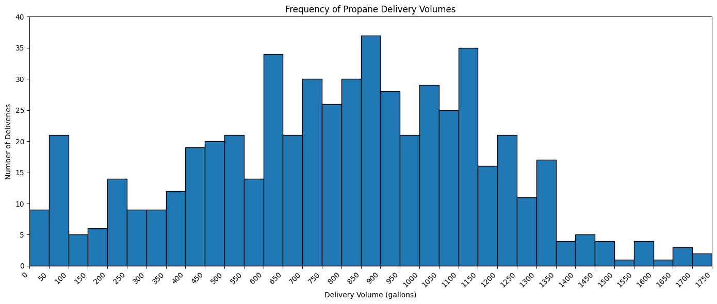
Propane Delivery Frequency

Slide 8
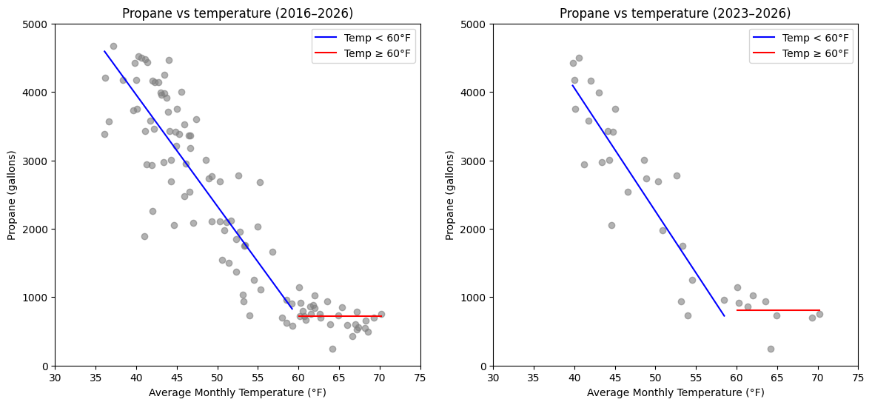
Propane vs. Temperature Regression

Slide 9
Regression Results
2023-2026 results were used to allocate propane usage by building
Site EUIs were estimated using Building Performance Database and then normalized to our data
EUIs may need further tuning based on building energy envelopes
Building | Area (sqft) | Heater efficiency | Site EUI (kBTU/ft²-yr) | Annual fuel energy (MMBtu/yr) | Propane allocation:
Longhouse | 6000 | 83% | 87 | 523.9 | 35.2%
Education Center | 4060 | 83% | 65 | 262.8 | 17.6%
CFS | 6681 | 80% | 72 | 480.0 | 32.2%
Stoves/DHW/misc. | - | - | - | 223.1 | 15.0%

Slide 10
Heating Profile Assumptions
We are trying to construct an annual heating profile based on propane delivery data, but want to ask about some assumptions.
Are the stoves/DHW used every day?
Are the Longhouse/Education Center/CFS only heated on weekdays?

Slide 11
ReOpt Assumptions - Utilities
Electricity rate: PSE 24, Three Phase
Single phase or three phase? Small life cycle cost reduction increase for three phase over single phase of about $4K over 25 years, no other changes
Compensation type: Net metering
Net billing is another possibility - specify $/kWh exported
When set to no compensation/incentives: PV w/o battery is still cost effective, saving ~$100K over 25 years compared to current system but requiring a larger PV size (74 kW vs. 59 kW)
Look into this more - find out potential net billing #s

Slide 12
ReOpt Assumptions - Utilities
Net Metering System Size Limit: 100 kW
WA state maximum system generating capacity
Compensation beyond annual grid purchases
Currently assumed $0/kWh
Heating System Fuel Type - Propane
Annual Existing Heating System Fuel Cost
From FerrellGas 2025-2026 data: $2.02/gal overall, $2.25/gal if removing maintenance deductions (only slightly greater life cycle cost savings at the $2.25/gal, ~$4K over 25 years)
Leave bigger number, better to overestimate
ReOpt could vary this by month

Slide 13
ReOpt Assumptions - Financial
Analysis period: 25 years & 10 years (if battery)
Host discount rate, nominal: Inflation, 2.5%
The rate at which the host discounts the future value of all future costs and savings. Note this is an after tax discount rate if the Host is a taxable entity.
Electricity cost escalation rate: 6%/year
Fuel cost escalation rate: 3.48%/year (default), 8.48%/year (US Residential Propane Price)
Notes:
Hannah

Slide 14
ReOpt Assumptions - Financial* not necessary
Minimum capital cost, before incentives: $0
Optional user input to set the minimum upfront capital cost for all technologies, excluding incentives and replacement costs.
Maximum capital cost, before incentives: $?
Optional user input to set the maximum up-front capital cost for all technologies, excluding incentives and replacement costs.
Would we like to define a max?
Notes:
Hannah

Slide 15
ReOpt - Findings With Battery
Changing settings:
Energy Capacity cost ($/kWh) = $200
Power Capacity cost ($/kW) = $400
Constant cost ($) = $50,000 (high end)
Technologies Selected: PV, Battery, ASHP Space Heater
Minimum Energy capacity (kWh) 65.0
Minimum Power Capacity (kW) 65.0
https://www.gsl-energy.com/the-real-cost-of-commercial-battery-energy-storage-in-2025-what-you-need-to-know.html#:~:text=in%20energy%20storage.-,Average%20Cost%20of%20Commercial%20Battery%20Energy%20Storage,on%20the%20components%20and%20complexity.

Slide 16
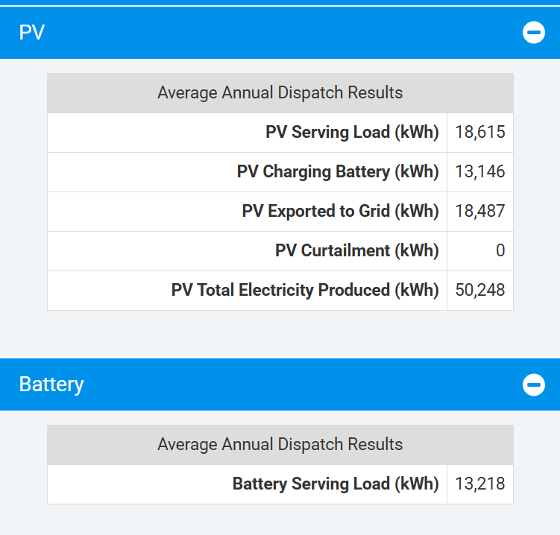
ReOpt - Findings With Battery
Negative return on investment in the long-term
$195,050 life cycle savings over 25 years
Payback period of 17.45 years
Internal Rate of return 4.3%
Capital cost estimates
Total Year 1 Utility Energy Cost decreased by -$12,721
Heating system fuel cost $964
PGST Trial 5 | REopt Web Tool | REopt Energy Integration & Optimization | NLR

Slide 17
ReOpt - Flex Battery Program Setup
Initial capacity rebate accounting
Flex event participation accounting
Assumptions: 60 kW battery, 100 flex events per year
Decreased constant cost

Slide 18
ReOpt Assumptions - Air-Source Heat Pump
Total Installed Cost: $0.01/ton (assumed none) - use default to figure out how much needs to be covered by grants
Incremental O&M Cost Increase Over Existing HVAC System ($/ton/yr): default at $0/ton/yr
ASHP Performance (COP and CF) Table
Appears to match the state-required minimum COP of 3.6 at 50°F. Is it fine to leave this at the default?
Heat Pump Capacity Sizing Factor: default at 1.1
Avoided HVAC Upgrades: $0 (if current HVAC is not aged)
Resistive Heating Backup Temp. Threshold: 10°F default
MACRS was ignored - no taxes

Slide 19
Next Steps
Update ReOpt inputs based on feedback
Adding more specific values for battery cost data
Continue refining propane consumption estimates
Estimate yearly use of each propane consumer
Determine propane consumption split
Sizing heat pumps to replace boiler/furnaces

Slide 20
Thank you!

